Slide 1
SQL Programming
Set Theory

Slide 2
Module 13: Set Theory Page A-1: Intro
In this module we examine the theoretical foundations of relational database technology and the SQL programming language.
At the outset I should warn you that I’ll be using two different vocabularies in this module.
One vocabulary includes the terms from the theoretical side of the material (eg. Tuples, attributes, project, product). The other vocabulary uses the terms we’re familiar with in SQL.
SQL is built on top of the theoretical foundations of relational theory. Relational theory has its own terminology. SQL also has its own vocabulary.
You should ‘appreciate’ that the theory (relational theory) is not the same as the application (SQL) of that theory.

Slide 3
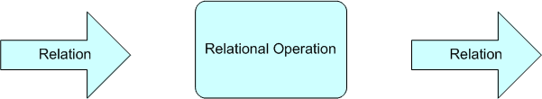
Module 13: Set Theory Page B-1: Relational Theory
Relational database systems are predicated on the notion of relations.
A relation is a “set of data”, and you can imagine the organization, or structure, of this set-like object as being analogous to a 2-dimensional table.
There are specific operations that can be performed on these relations (eg. Joining), and an important feature of these operations is that they all preserve the ‘closed’ nature of relations.
The relational system is defined as a closed system, because its outputs are the same ‘type’ as its inputs. That is, relations come in to an operation, and relations come out of an operation. We’ve mentioned this feature once before in the course when we discussed subqueries, and it’s this property of closed systems that allows us to string (or nest) one query after another, after another, after …

Slide 4
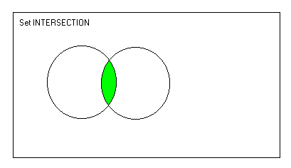
Module 13: Set Theory Page B-2: Set Theoretic
Some features of SQL derive from its set-theoretic foundations.
These features may be reminiscent of the set theory you studied back in grade school, and the set-theoretic operations that SQL provides are:
union
intersection
difference

Slide 5
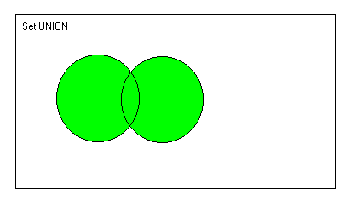
Module 13: Set Theory Page B-3: Union
The union operation “unites” the elements of one set with the elements of another set.
The Venn diagram that accompanies this slide depicts the union operation.
Each circle represents a set of elements. The union operation is the sum of the two sets.
I think of the union operation as ‘adding’ two sets together.

Slide 6
Module 13: Set Theory Page B-4: Union Compatible
Tables that are union-ed must be union-compatible.
This restriction is similar to the old admonition that you can’t add apples and oranges.
Union-compatiblity requires that
The tables share the same number of columns, and
The corresponding columns must be drawn from the same domain.

Slide 7
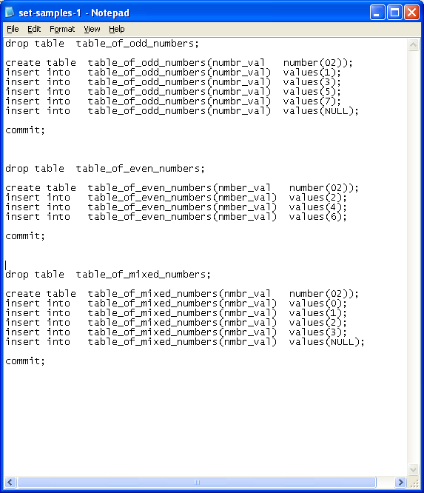
Module 13: Set Theory Page B-5: Sample Tables
Let’s consider these tables as we run thru some examples in this module.
table_of_odd_numbers
1, 3, 5, 7, NULL
table_of_even_numbers
2, 4, 6
table_of_mixed_numbers
0, 1, 2, 3, NULL
Please note that the column names are different in each table, but that each of these columns is drawn from the same domain (numeric values)

Slide 8
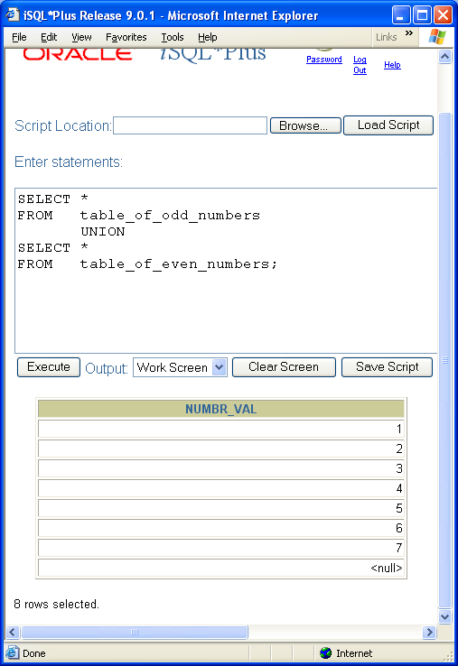
Module 13: Set Theory Page B-6: Union Example
table_of_odd_numbers
1, 3, 5, 7, NULL
table_of_even_numbers
2, 4, 6
The first working table that SQL builds includes all of the rows from the table_of_odd_numbers.
To this working table, all of the rows from the table_of_even_numbers are added.
And then all of these rows are presented in the result table.

Slide 9
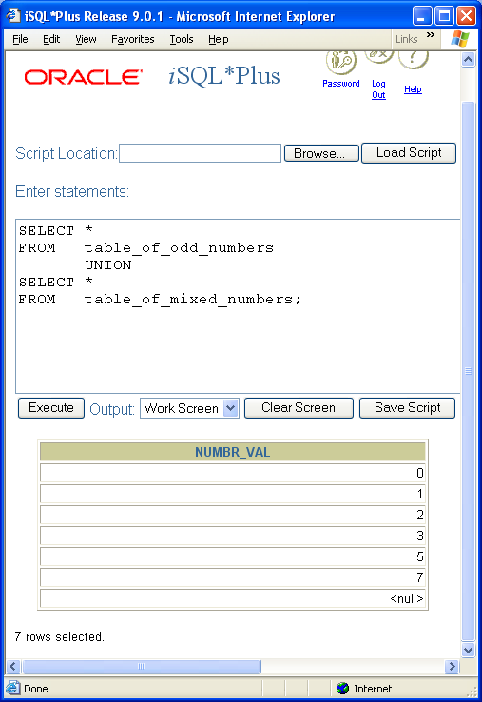
Module 13: Set Theory Page B-7: Union Example
table_of_odd_numbers
1, 3, 5, 7, NULL
table_of_mixed_numbers
0, 1, 2, 3, NULL
Notice that duplicate rows are automatically removed from the final result table.
This is a feature of the set theory upon which relational database systems (and SQL) are built.
A set does NOT contain duplicate elements.
And by extension, tables do not (should not) contain duplicate rows.

Slide 10
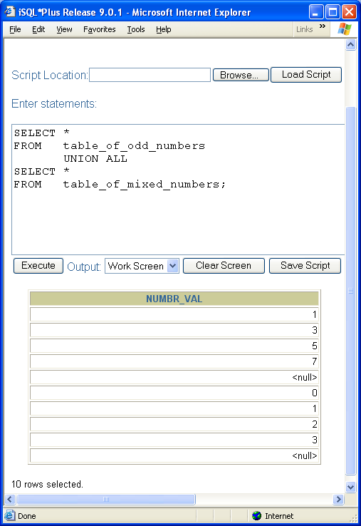
Module 13: Set Theory Page B-8: UNION ALL Example
But there are some times when it’s beneficial to see ‘all of the rows’, even the duplicates.
So, most database vendors provide a UNION ALL clause that allows duplicate rows to be carried forward to the final result set.
Here’s an example:
table_of_odd_numbers
1, 3, 5, 7, NULL
table_of_mixed_numbers
0, 1, 2, 3, NULL
Oracle and MySQL both provide an extension to the UNION operation in their version of SQL. THE ALL phrase (UNION ALL) preserves duplicate rows in the result table.
Note especially how NULL values are preserved.

Slide 11
Module 13: Set Theory Page B-9: ORDER BY
Each union ‘block’ can be sorted, and if this is needed, the ORDER BY clause is included “inside” the SELECT clauses.
If the outcome of all of the unions combined, needs to be sorted, then the ORDER BY clause is included “outside” all of the SELECT clauses. This is accomplished by placing each SELECT clause inside a pair of parenthesis, and having the ORDER BY clause appear outside of any of the parenthetical expressions.
Notice the ‘distinction’ between these two sets of code:
(SELECT id, name FROM student)
UNION ALL (SELECT id, name FROM faculty)
ORDER BY name
(SELECT id, name FROM student
ORDER BY major, name)
UNION ALL (SELECT id, name FROM faculty)

Slide 12
Module 13: Set Theory Page B-10: Intersection
The intersection operation returns the elements that are common to each set.
This Venn diagram provides a graphical illustration of that concept.
Once again, the circles represent two different sets of data, A and B. The shaded region in the diagram highlights the area that represents elements that are common to the two sets.

Slide 13
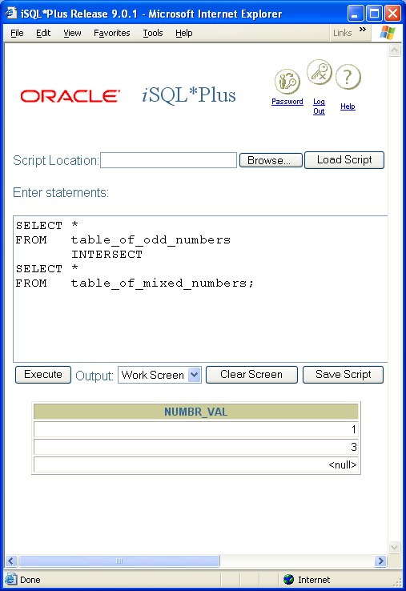
Module 13: Set Theory Page B-11: Intersection Example
table_of_odd_numbers
1, 3, 5, 7, NULL
table_of_mixed_numbers
0, 1, 2, 3, NULL
Notice, that for purposes of intersection, SQL considers NULL values to be equal to one another.

Slide 14
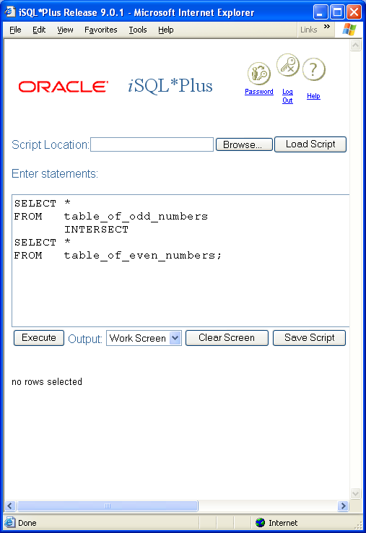
Module 13: Set Theory Page B-12: Intersection Example
table_of_odd_numbers
1, 3, 5, 7, NULL
table_of_even_numbers
2, 4, 6
When the tables have no rows in common, the result table is empty.

Slide 15
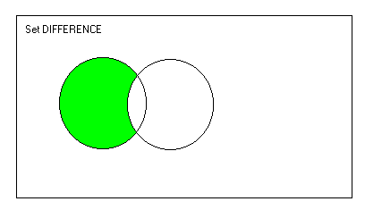
Module 13: Set Theory Page B-13: Difference
The difference between two sets is the set of elements that are in the first set, but are not in the second set.
Once again, we’ll use a Venn diagram to illustrate this point. Here are two sets of data, A and B. The shaded area represents those elements in A that are not in B.
I think of the difference operation as being analogous to subtraction. In a sense we are saying, remove all of the B elements from A.
Special note: unlike the other set theoretic operations, this operation is not transitive. The order in which we specify the operands will have an effect on the operation.
A MINUS B is not the same as B MINUS A

Slide 16
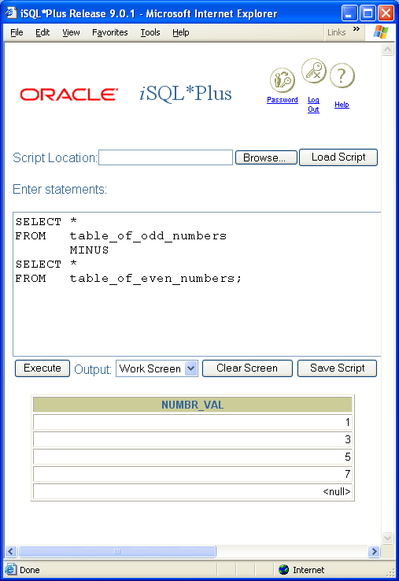
Module 13: Set Theory Page B-14: Difference Example
table_of_odd_numbers
1, 3, 5, 7, NULL
table_of_even_numbers
2, 4, 6
When the tables have no rows in common, the result table is, essentially, a copy of the first table.

Slide 17
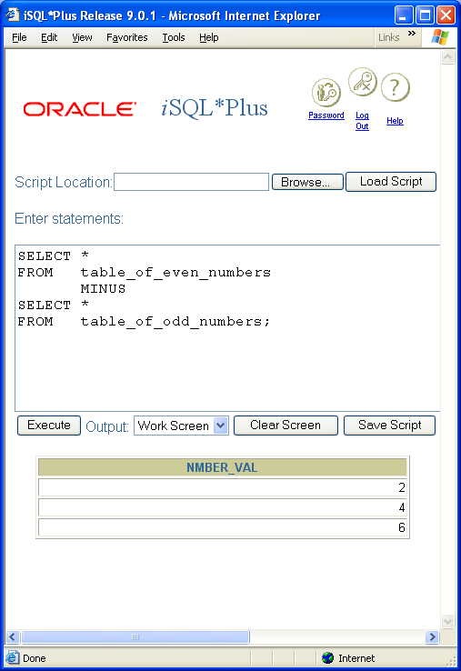
Module 13: Set Theory Page B-15: Difference Example
table_of_odd_numbers
1, 3, 5, 7, NULL
table_of_even_numbers
2, 4, 6
When the tables have no rows in common, the result table is, essentially, a copy of the first table.

Slide 18

Module 13: Set Theory Page B-16: Difference Example
table_of_odd_numbers
1, 3, 5, 7, NULL
table_of_mixed_numbers
0, 1, 2, 3, NULL
Notice once again, that for the SET theoretic operations, SQL considers NULL values to be equal to one another.

Slide 19
Module 13: Set Theory Page B-17: Core Functions
Some theoreticians make a point of identifying the core set of operations in any language. In this regard, the term core means essential, and more specifically the ‘building blocks’ of all other operations.
The core operations in the set-theoretic group of operations are:
union, and
difference
All of the other operations (ie. Intersection) can be derived from these two.

Slide 20
Module 13: Set Theory Page B-18: Core Functions
Over the next couple of slides we’ll demonstrate how the intersection operation can be accomplished through the difference operation.

Slide 21
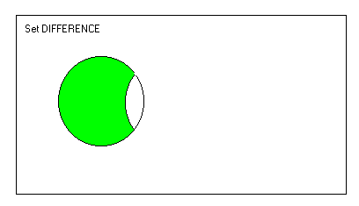
Module 13: Set Theory Page B-19: Core Functions
Specifically, A INTERSECT B, can be accomplished with two DIFFERENCE operations.
First, take the difference of A and B,
(ie. A-B).

Slide 22
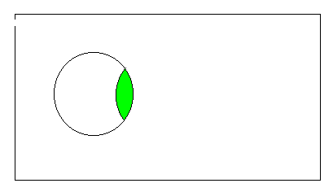
Module 13: Set Theory Page B-20: Core Functions
Specifically, A INTERSECT B, can be accomplished with two DIFFERENCE operations.
First, take the difference of A and B, (ie. A-B, and let’s refer to this as C).
Next take the difference of A with C (ie. A-C).

Slide 23
Module 13: Set Theory Page C-1: Relation Theoretic
The relational operations, (or relational theoretic operations), together with the set operations, constitute the relational algebra!
The relational operations that we’ll cover include:
rename
project
select
product (ie. Cartesian product)
natural join

Slide 24
Module 13: Set Theory Page C-2: Rename
The rename operation allows for a relation to be renamed. It also allows for the attributes of a relation to be renamed.
The rename operation is a property of relations. In SQL, the rename operation is accomplished by table aliases and column aliases.

Slide 25
Module 13: Set Theory Page C-3: SELECT
The select operation specifies which tuples are to be included in the output relation.
In this regard, the select operation provides a means for extracting a horizontal (ie. row) subset from the base relation.
In SQL, the select operation is accomplished with the WHERE clause.

Slide 26
Module 13: Set Theory Page C-4: PROJECT
The project operation specifies which attributes should be included in the output relation.
In this regard, the project operation provides a means for extracting a vertical (ie. columnar) subset from the base relation.
In SQL, the project operation is accomplished with the SELECT clause.

Slide 27
Module 13: Set Theory Page C-5: Product
The relational operation product, combines each of the rows in one relation, with each of the rows in another relation.
The product of two tables is accomplished in SQL with a cross join.

Slide 28
Module 13: Set Theory Page C-6: Natural join
The relational operation of a natural join combines each of the rows in one relation, with each of the rows in another relation. It also ensures that the duplicate (redundant) columns are removed from the resulting relation.
The natural join of two tables is accomplished in SQL with a NATURAL JOIN.

Slide 29
Module 13: Set Theory Page C-7: Core Operations
The core group of relational operations includes:
rename
project
select
product
As an exercise for the student (one that you’ve already performed in the homework assignment on joins), demonstrate for yourself that a natural join derives from the core set of operations.

Slide 30
Module 13: Set Theory Page T-1: Terminology
Set theoretic, set operations
Union, UNION, UNION ALL
Intersection, INTERSECT
Difference, MINUS
Union compatible
Venn diagram
Relational theoretic, relational operations
Rename (ALIASES)
Select (WHERE)
Project (SELECT)
Product (JOIN)
Natural join (NATURAL JOIN)

Slide 31
Module 13: Set Theory Page Z-1: End Notes
Please drop me an email if you noticed any errors in this module. I’d also appreciate reading your comments, criticisms, and or suggestions as to how this module could be improved.
Were there any gaps in the information that was presented (ie. ‘leaps of faith’)?
Was any section unclear?
Did I happen to do a good job? ☺
Thanks,
bil

Slide 32
That’s All

